Slide 1

Hospital Performance & Patient Analytics
Analysis of ~56,000 patient records to evaluate admissions, demographics, diagnoses, costs, and hospital utilization. Tools: Python (cleaning & EDA), PostgreSQL (analysis), Power BI (interactive dashboards).

Slide 2




Dataset Snapshot
Patient Info
Medical Info
Hospital Details
Financial & Time
Name, Age, Gender, Blood Type, Age Group
Conditions, Medications, Test Results
Hospital, Admission Type, Length of Stay
Billing, Insurance Provider, Admission/Discharge dates, Season
Preprocessing: standardized columns, datetime conversion, created Age Group, Length of Stay, Season. No major inconsistencies found.

Slide 3

EDA & Feature Engineering (Python)
Key steps
Imported into pandas for cleaning and exploration
Checked dtypes, summary stats, duplicates, missing values
Removed duplicates; standardized snake_case column names
Engineered: Age Group, Length of Stay, Season
Exported cleaned data to PostgreSQL for SQL analysis

Slide 4




Demographics & Admissions
Age & Gender
Adult F: 6,910 • Adult M: 6,947 • Middle-aged F: 10,960 • Middle-aged M: 10,769 • Minor F: 2,901 • Minor M: 2,851 • Senior F: 7,184 • Senior M: 6,978
Admission Types
Emergency 36.22% (20,104) • Elective 23.93% (13,280) • Urgent 21.29% (11,816) • Routine 18.56% (10,300)
Monthly & Seasonal
Monthly admissions ~4,200–4,800. Seasonal totals: Summer 14,343 • Spring 13,789 • Autumn 13,772 • Winter 13,596

Slide 5
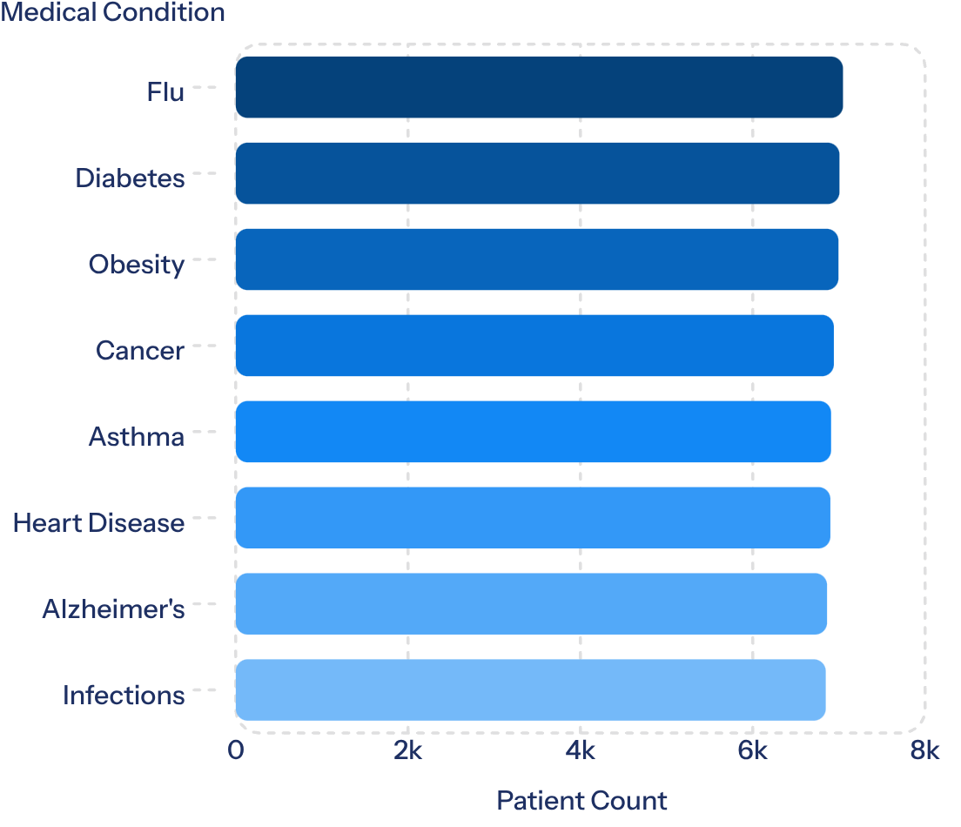

Most Common Conditions
Understanding disease frequency helps prioritize resources, staffing, and preventive care programs.

Slide 6
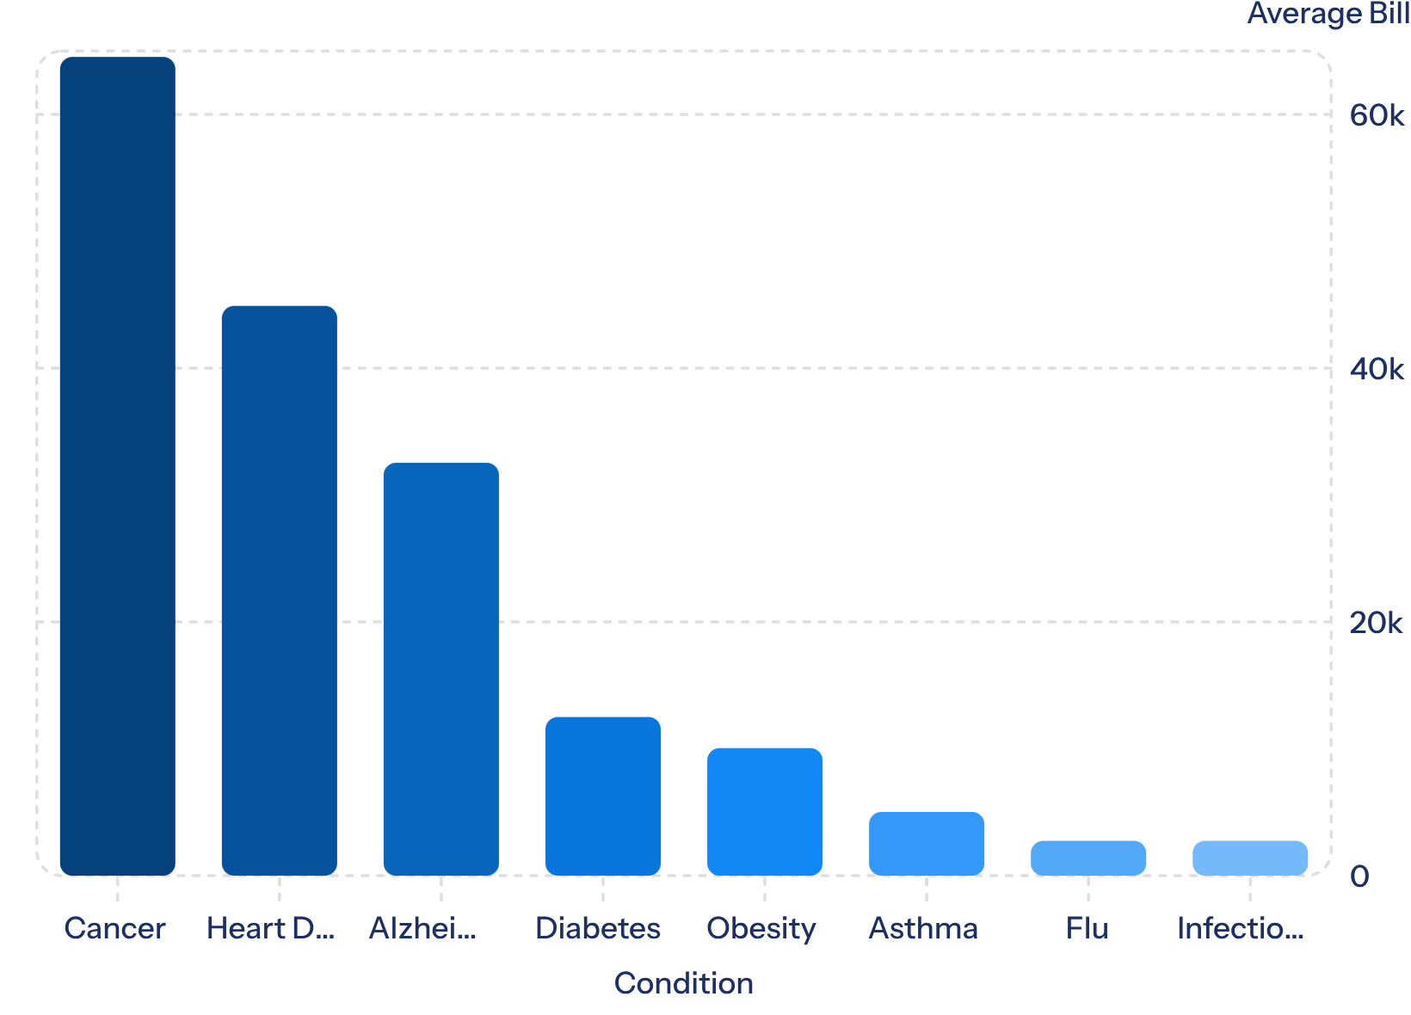
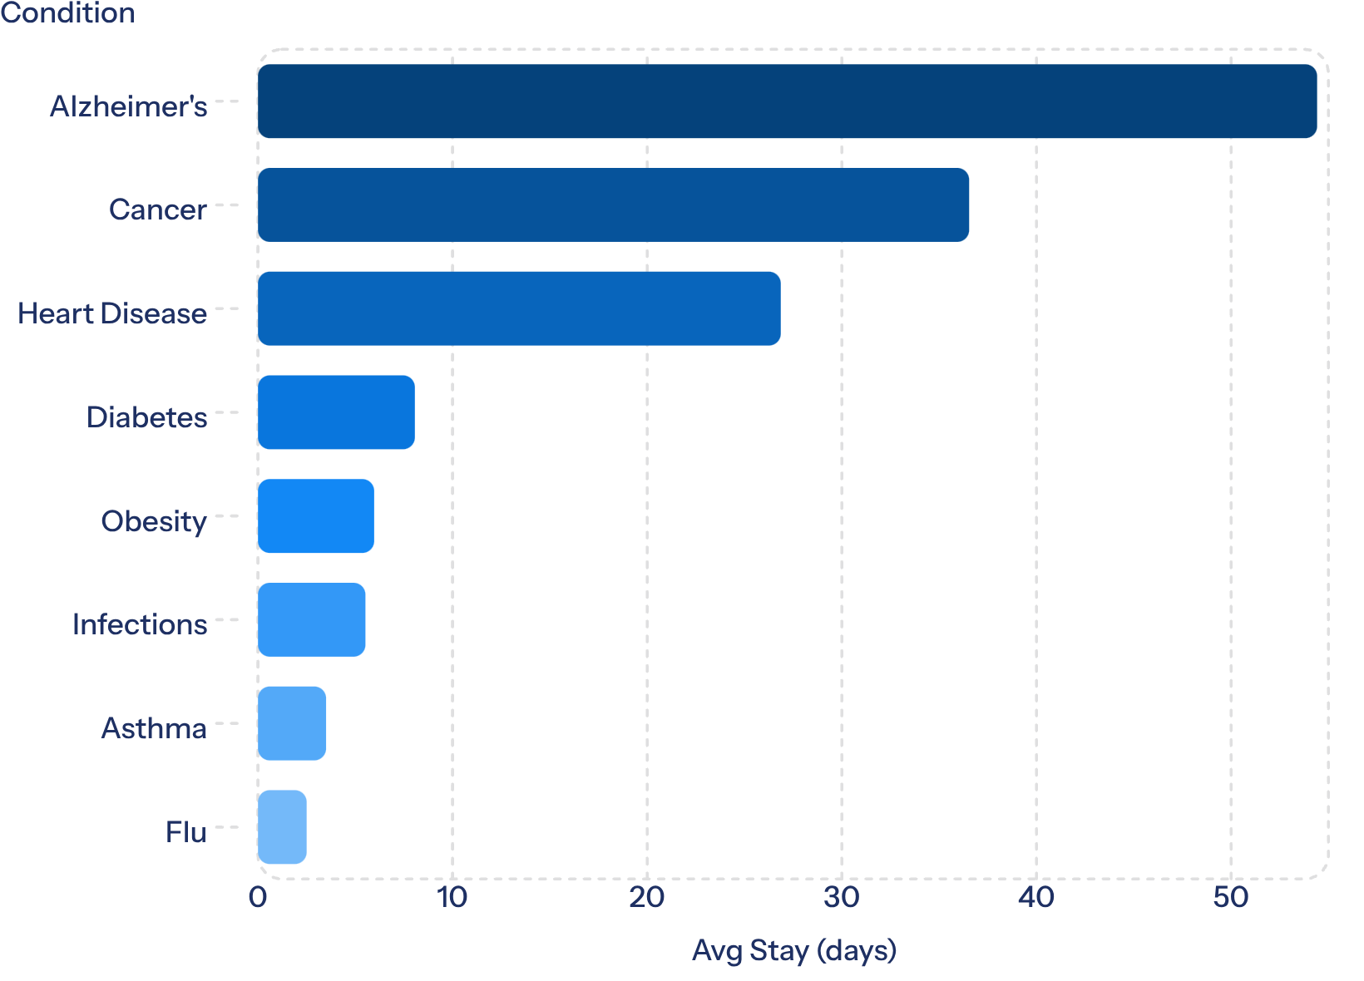
Costs & Length of Stay by Condition
Insights: Cancer drives highest average bills; Alzheimer's requires longest stays—informing resource & cost planning.

Slide 7
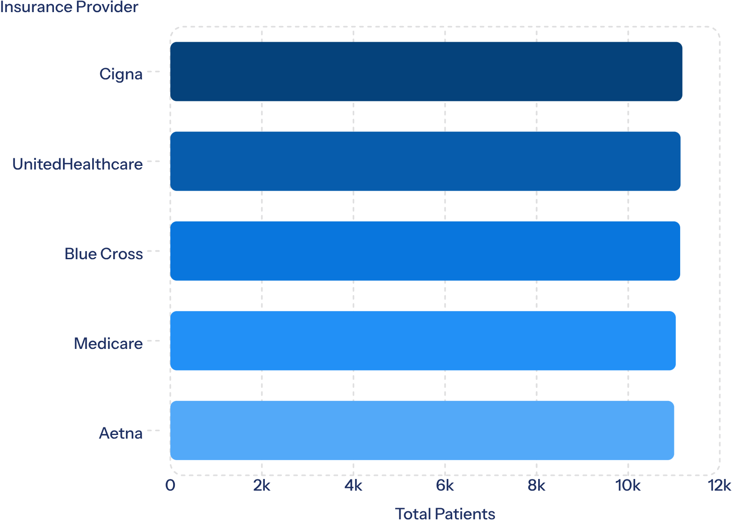
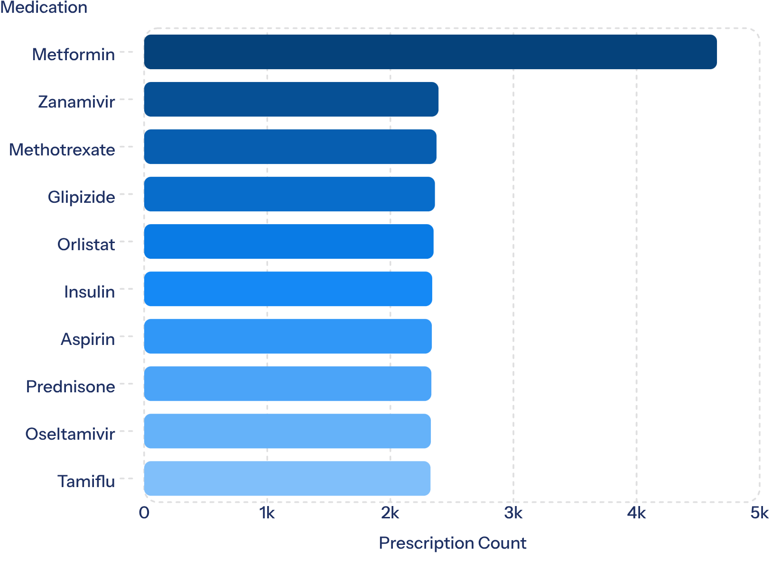
Insurance & Medication Insights
Prioritize inventory for top-prescribed medications and maintain strong insurer partnerships to secure revenue streams.

Slide 8
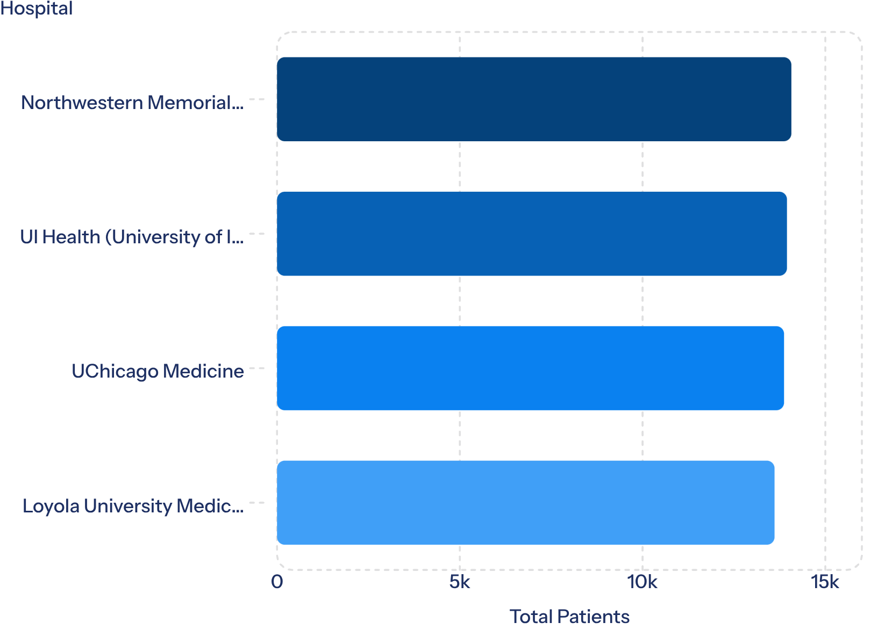
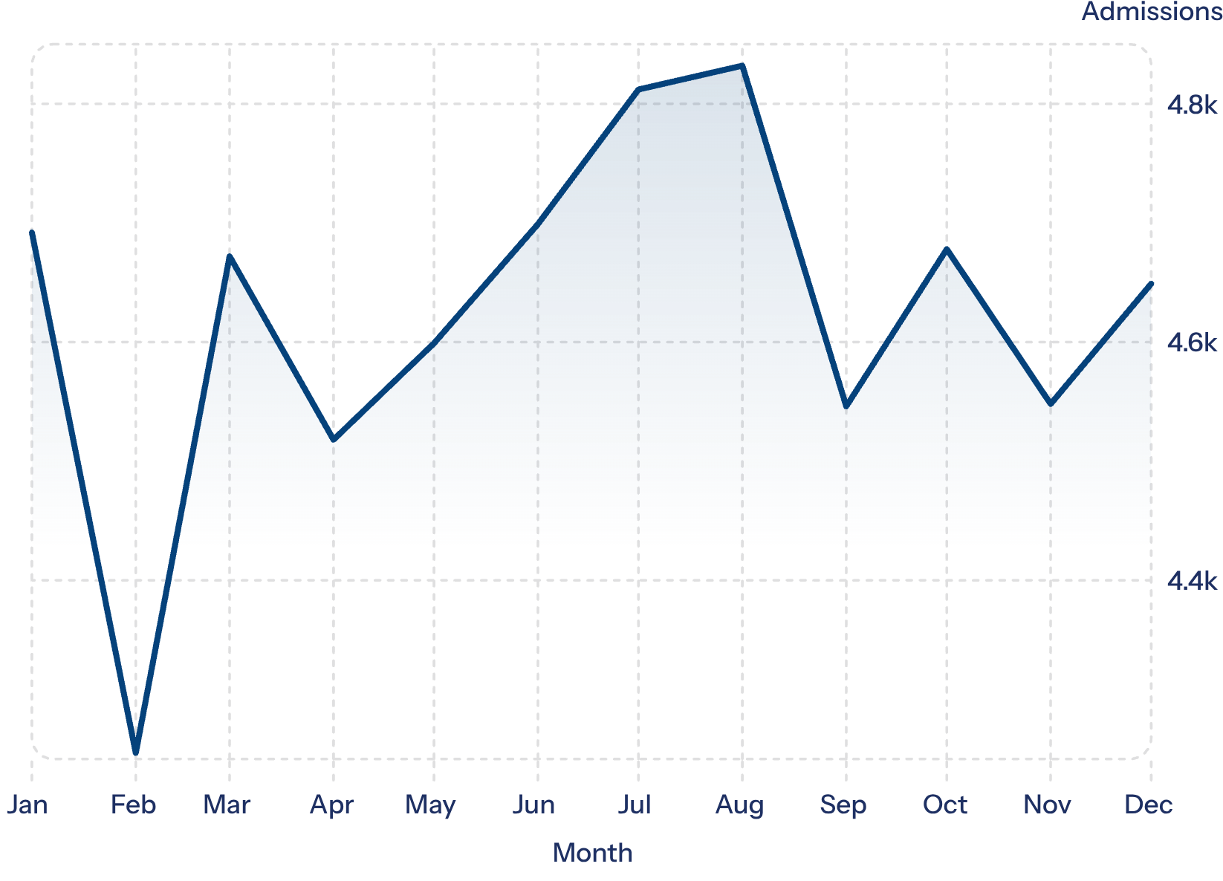
Hospital Performance & Trends
Hospital revenues and patient counts are similar across institutions; compare efficiency and outcomes to find improvement areas.

Slide 9

Power BI Dashboards
Dashboard 1 — Trends
KPIs: 56K total patients • 1.21bn total revenue • 21.84K avg bill • 17.84 avg stay • 4 hospitals
Patient count by condition
Billing by condition
Age group & gender distribution
Avg length of stay and admission type
Filters: Gender, Age Group, Condition, Insurance, Hospital, Season
Dashboard 2 — Overview
Operational views: monthly trends, hospital revenue comparisons, seasonal patterns, test results, insurance distribution, medication frequencies.

Slide 10
Business Recommendations
Preventive Healthcare
Resource Allocation
Cost Management
Invest in screenings and preventive programs for Diabetes and Heart Disease.
Allocate beds and specialist staff for Alzheimer's units due to long stays.
Target cancer treatment costs via efficiency, insurance collaboration, and care planning.
Seasonal Planning
Insurance & Inventory
Performance Monitoring
Adjust staffing and inventory for seasonal admission fluctuations.
Strengthen insurer partnerships and prioritize top-prescribed medication stock.
Benchmark hospitals on efficiency, outcomes, and service quality to find improvements.

